Slide 1
Lecture 9: the Function
main()
CSC111: Introduction to CS through Programming
R. Jordan Crouser
Assistant Professor of Computer Science
Smith College

Slide 2
Announcements
RSVP
by 9/29
bit.ly/2N1AKpu

Slide 3

Student Day @ the NERD on Monday 9/24
Tour the facility, visit with Boston-area Smith alums, see cool demos, check out the maker space, win cool prizes!
Travel support / carpooling available
Interested? Fill out the form posted to Slack or talk to Asmita (your CS Department Liaison)

Slide 4
About Assignment 2
92 / 92 assignments submitted on time (!!!)
Almost everyone included a header and had appropriate variable names (nice work)
Most submissions passed all automated tests on integers
Currently working on testing floats
A few notes on attributing resources:

Slide 5
A reminder from the syllabus
Attribution:
The names of all collaborating students should be listed at the top of the submission. [Note: this includes help from TAs.]
If you worked alone, please state: “I did not collaborate with anyone on this assignment.”
“References”
In-line citations to any resources you used, including page numbers (if a printed resource) or a direct URL (if an online resource).
If you did not use any resources in completing the assignment, please state: “I did not utilize any external resources in completing this assignment.”
Approximately 10% of A2 submissions had one ☹

Slide 6
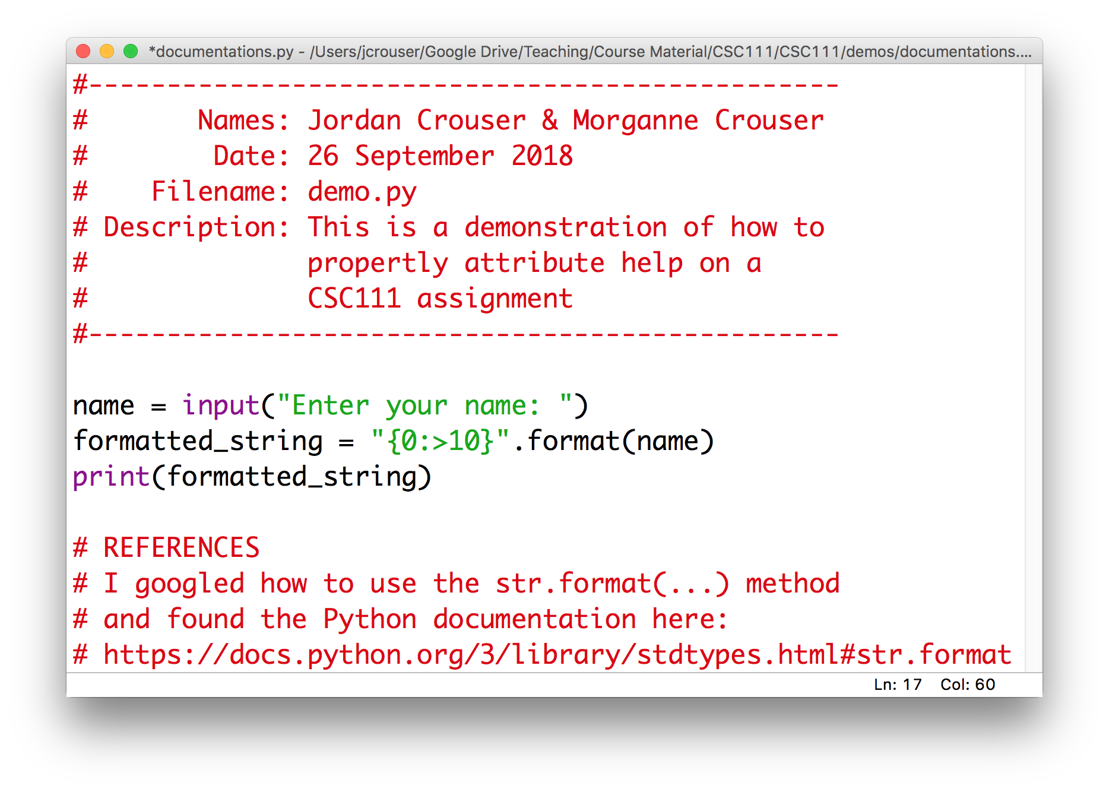
Here’s what I want to see

Slide 7
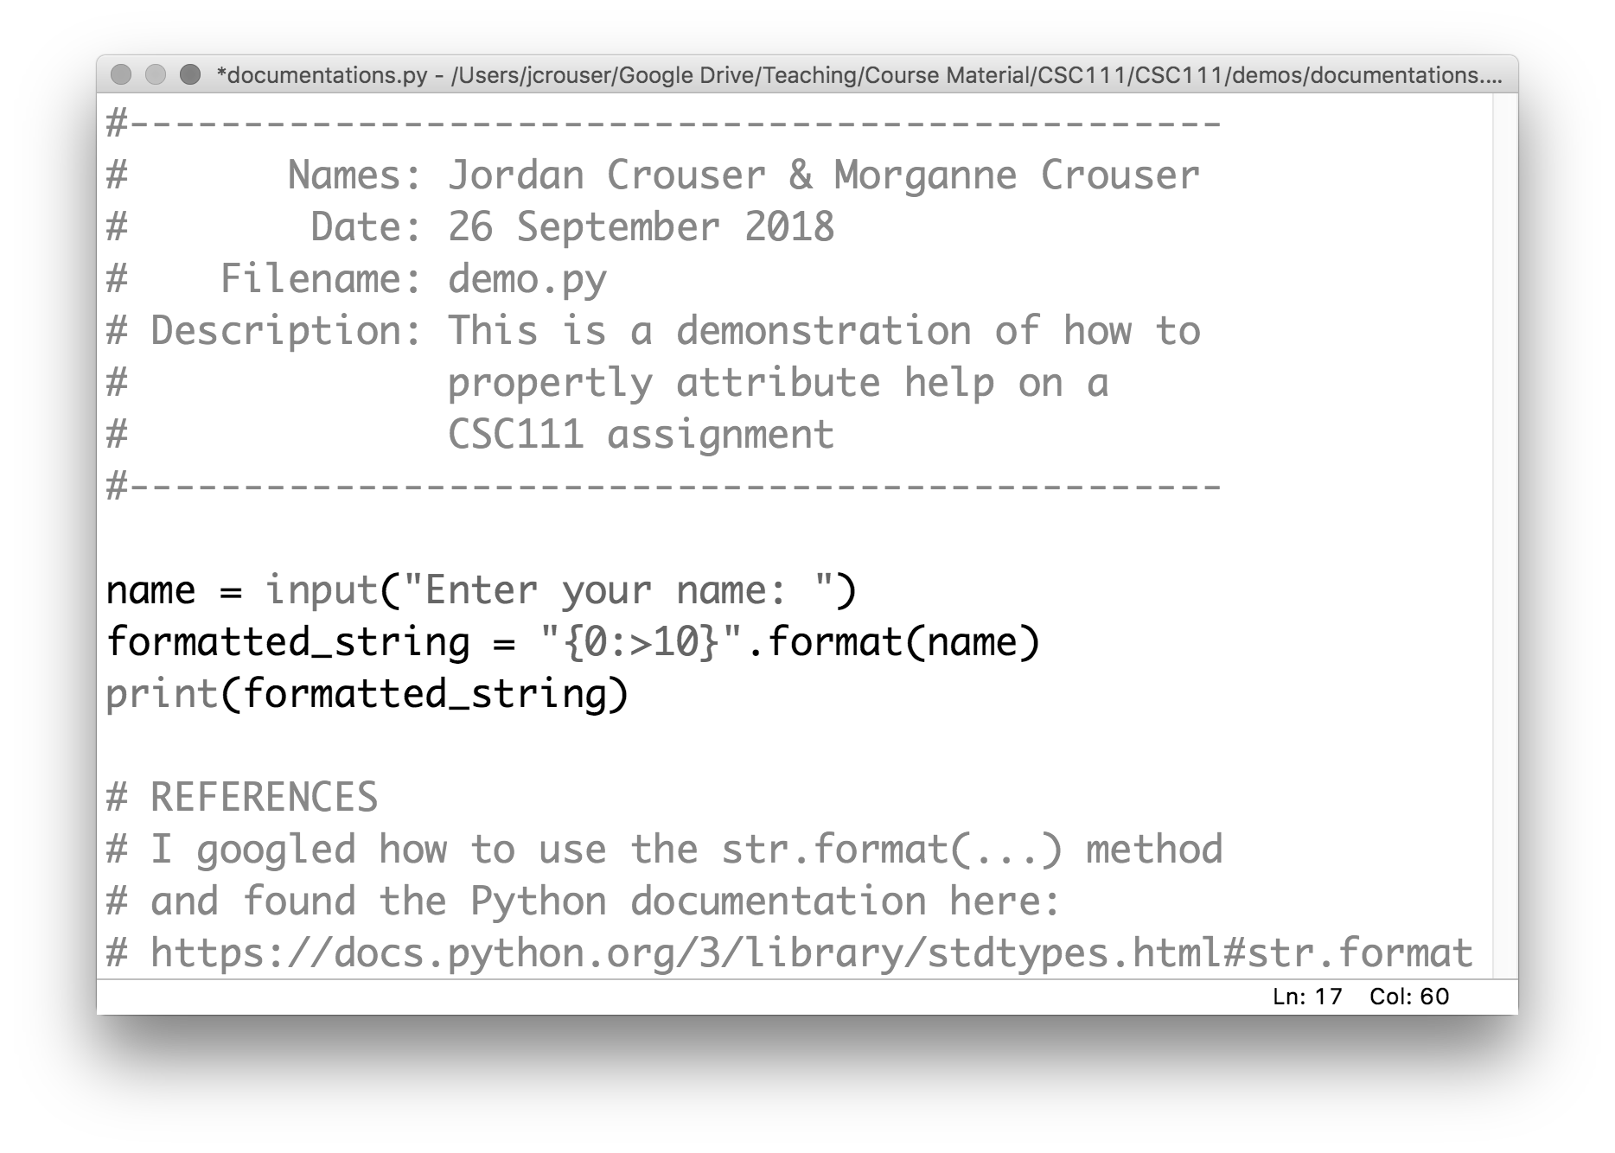
Here’s what I want to see

Slide 8
Here’s what I want to see

Slide 9
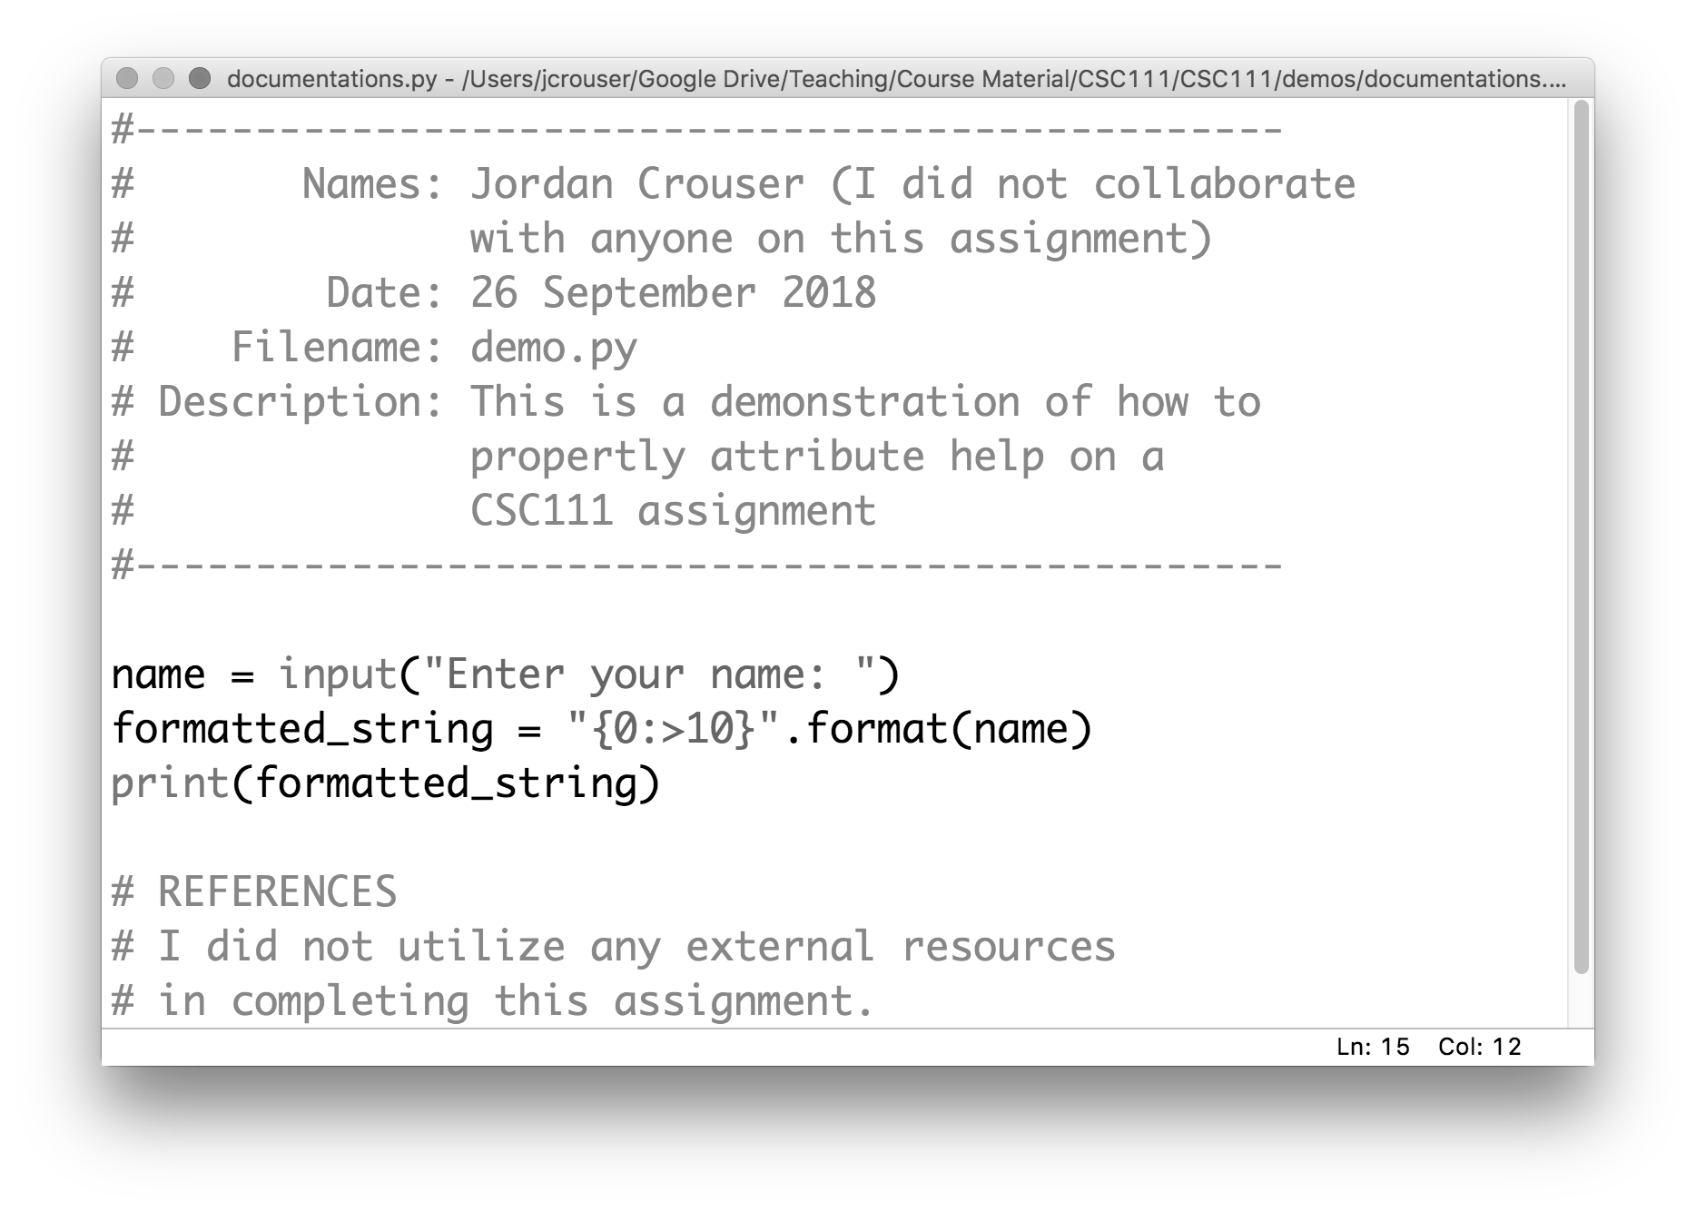
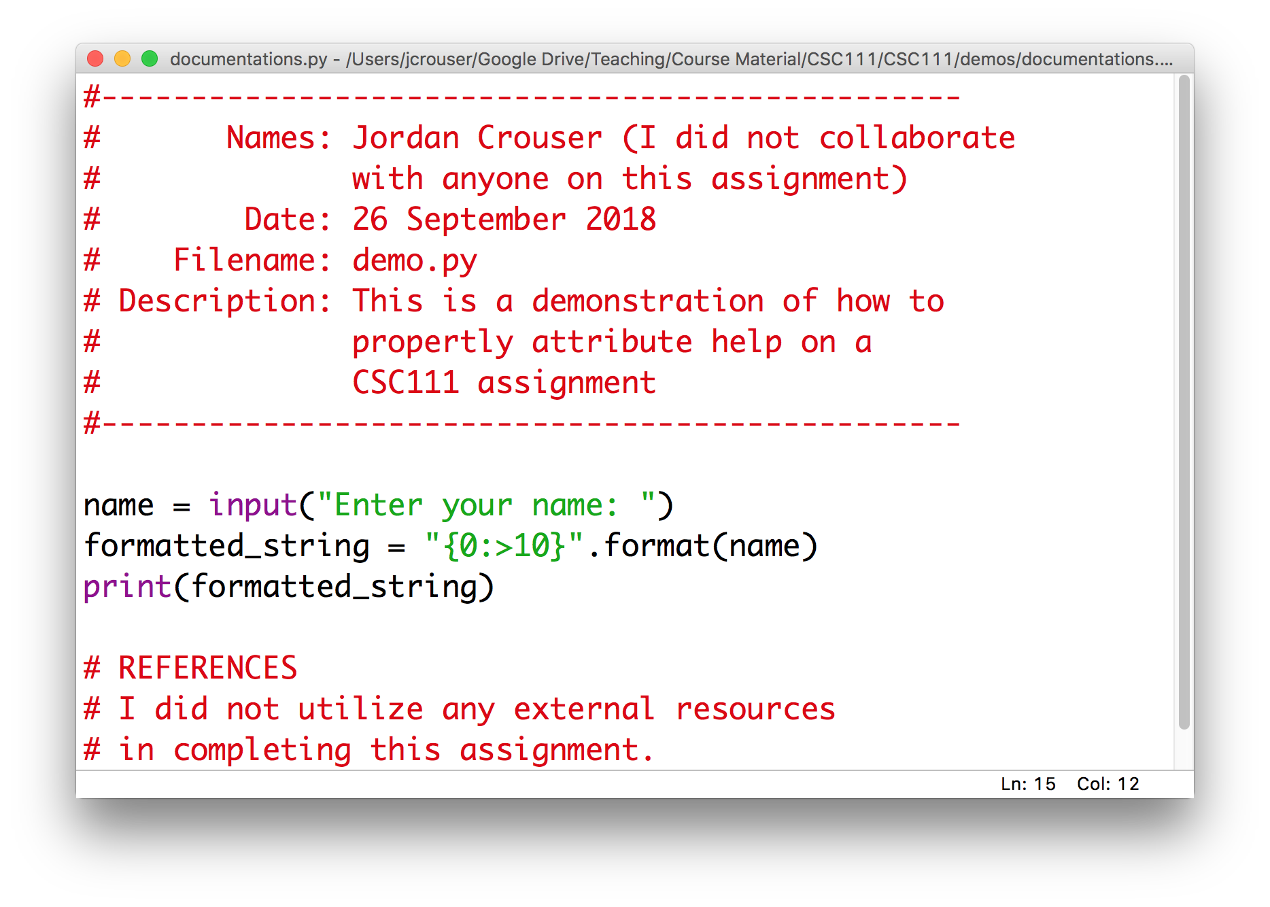
Here’s what I want to see

Slide 10
Here’s what I want to see

Slide 11
Overview
Recap of assignment 2
Strings
operations on strings
accessing individual letters
handy methods
The main() function
Lab: Pretty Printing
Life skill #2: debugging

Slide 12
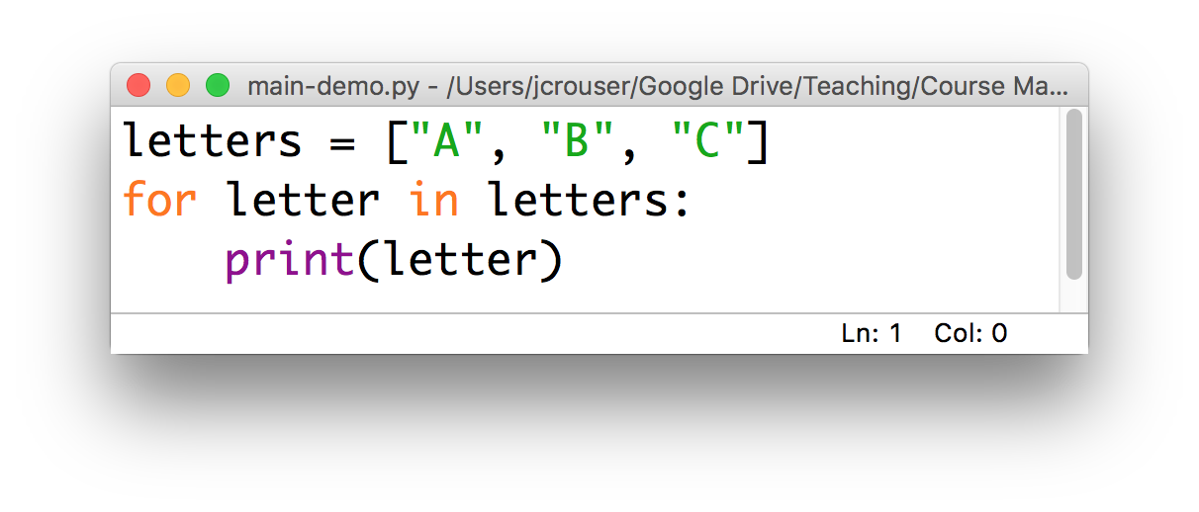
Recap
So far, we’ve been writing code in files as if we were writing it on the console:
When we do this, the Python interpreter executes everything from the top down

Slide 13
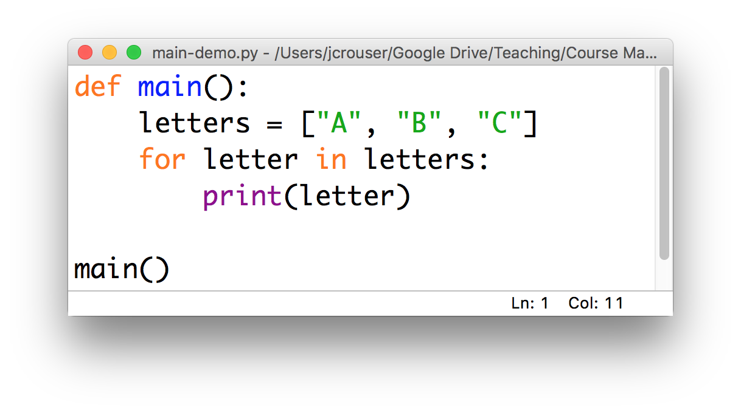
An alternative
It is better practice to write the code you want to execute inside a main() function, e.g.
This lets the interpreter ”read ahead” and then execute

Slide 14
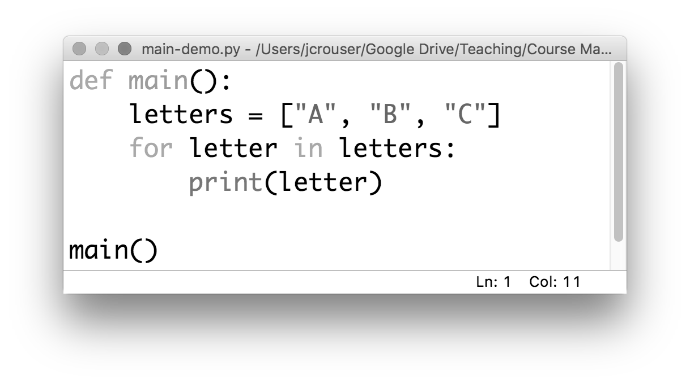
How this works
Remember: the interpreter reads from the top down, which means that it reads the definition first
Notes:
This is a lot like defining a variable (but instead of putting a value in the “box”, we’re going to fill it with code)

Slide 15
How this works
Then it reads each line inside the definition, but these don’t get executed yet

Slide 16
How this works
Then it reads each line inside the definition, but these don’t get executed yet

Slide 17
How this works
Then it reads each line inside the definition, but these don’t get executed yet

Slide 18
How this works
At this stage, we’ve given python a “recipe” for what we want it to do when we call main()
If we stop here, nothing will actually happen

Slide 19
How this works
The real work happens only when we actually call the main() function
When we do, python goes to the main() box and follows the instructions it finds there

Slide 20

Discussion
Why bother?

Slide 21
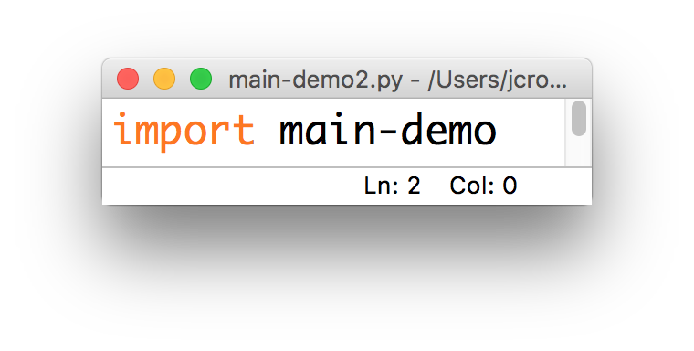
Just one more thing…
What happens if someday we want to use the code in this file as part of another program?

Slide 22
Discussion
What we need: a way to tell python to behave one way when we run it as a “stand-alone” program, and a different way when we import it
Ideas?

Slide 23
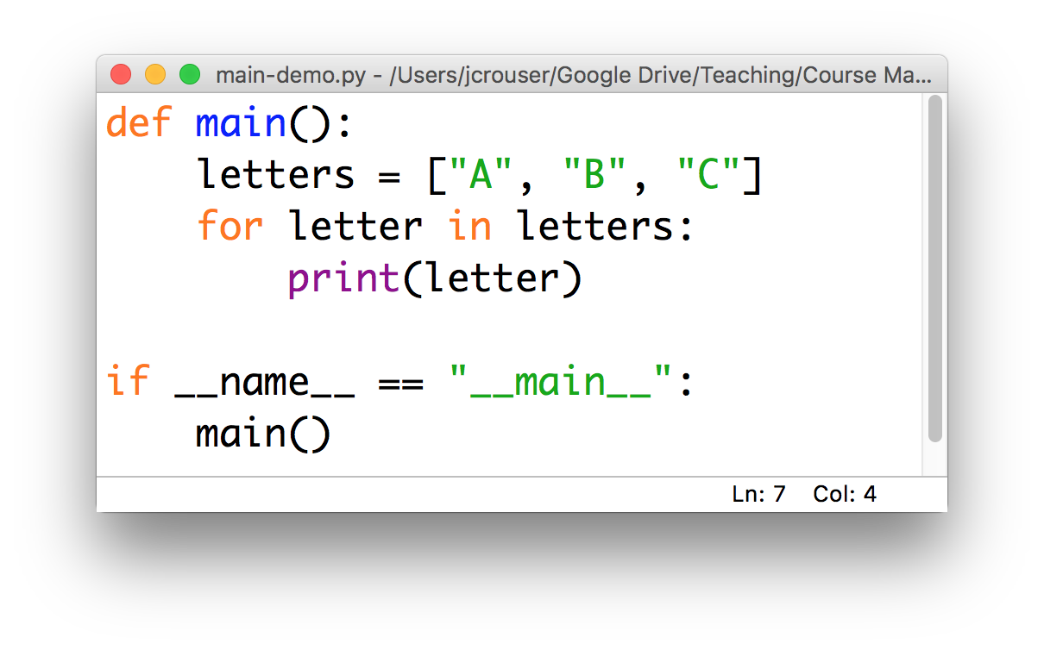
Python convention
We can use an if statement to tell python to call the main() function only if the program is being run directly

Slide 24
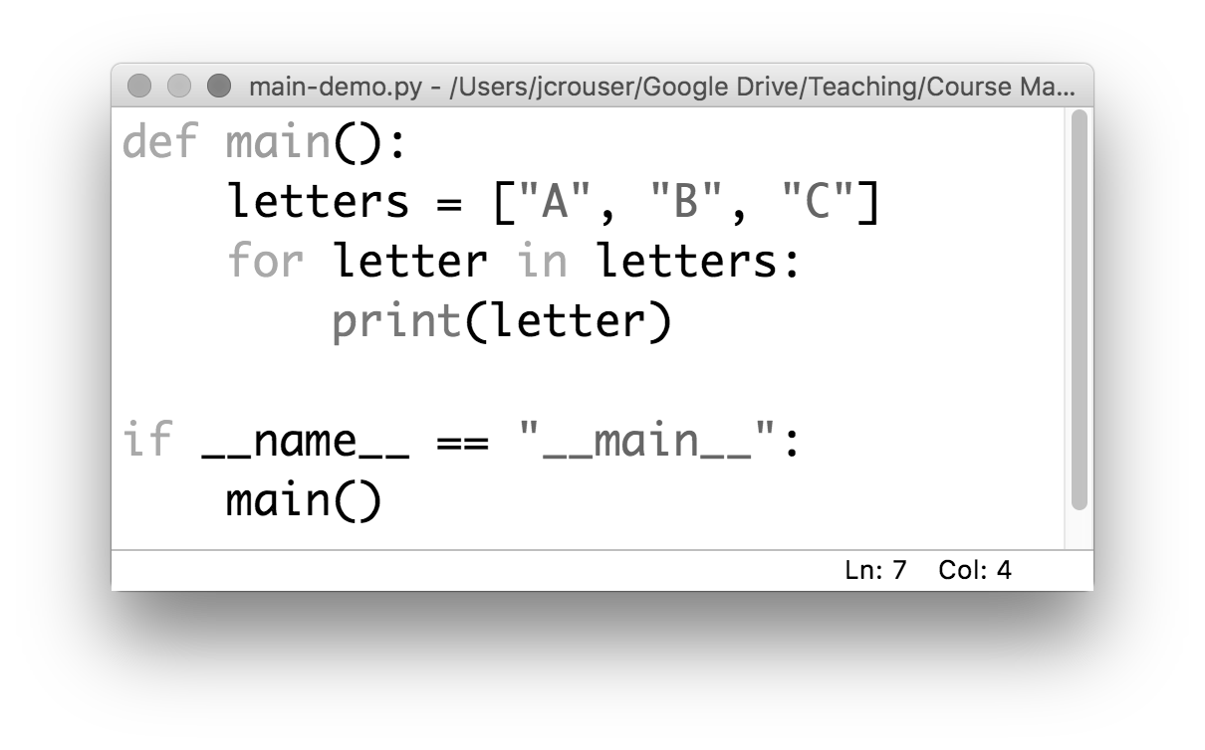
Python convention
This is a little bit confusing: we named the function we created to hold our program was called main()

Slide 25
Python convention
In our if statement, we’re asking whether some variable called __name__ is equal to the string "__main__"
(not to mention I don’t recall initializing anything called __name__...)

Slide 26
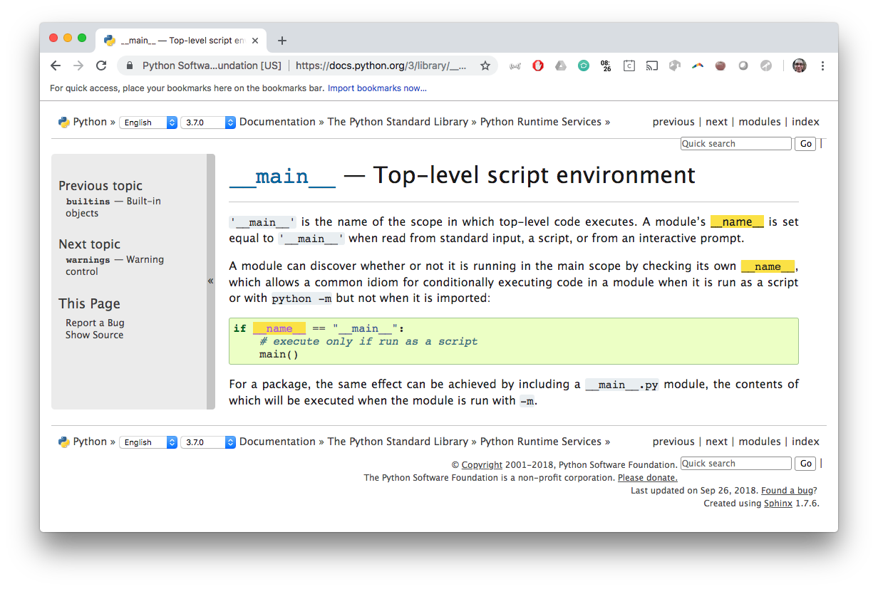
To the documentation!

Slide 27
Notes:
Let’s explore how this works.
Importing your own files (must be in same dir for now)

Slide 28
15-minute exercise
Write a program that contains a main() function, which contains instructions for printing out the phrase:
"Today is not mountain day :-("
Use an if statement combined with checking the value of the __name__ variable to call main() only when the program is run directly
Add an else statement so that whenever the program (“module”) is imported, it prints out the phrase:
"Maybe today...?"

Slide 29
Discussion
What did you come up with?

Slide 30
Takeaways
Programs (“modules”) that are well-organized are easier to read, more versatile, and potentially more efficient
The first step we’ll take toward organizing our code is to include a main() function, which includes the instructions we want our program to run
To make it easier to import code we write now into later modules, we will follow the convention of including:
if __name__ == "__main__":
main()
at the end of each module

Slide 31
Takeaways
Programs (“modules”) that are well-organized are easier to read, more versatile, and potentially more efficient
The first step we’ll take toward organizing our code is to include a main() function, which includes the instructions we want our program to run
To make it easier to import code we write now into later modules, we will follow the convention of including:
if __name__ == "__main__":
main()
at the end of each module

Slide 32
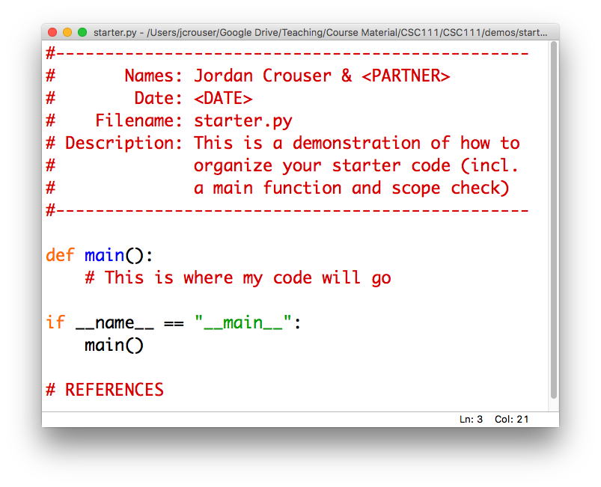
Helpful tip: have a starter template

Slide 33
Overview
Recap of assignment 2
Strings
operations on strings
accessing individual letters
handy methods
The main() function
Lab: Pretty Printing
Life skill #2: debugging

